Slide 1
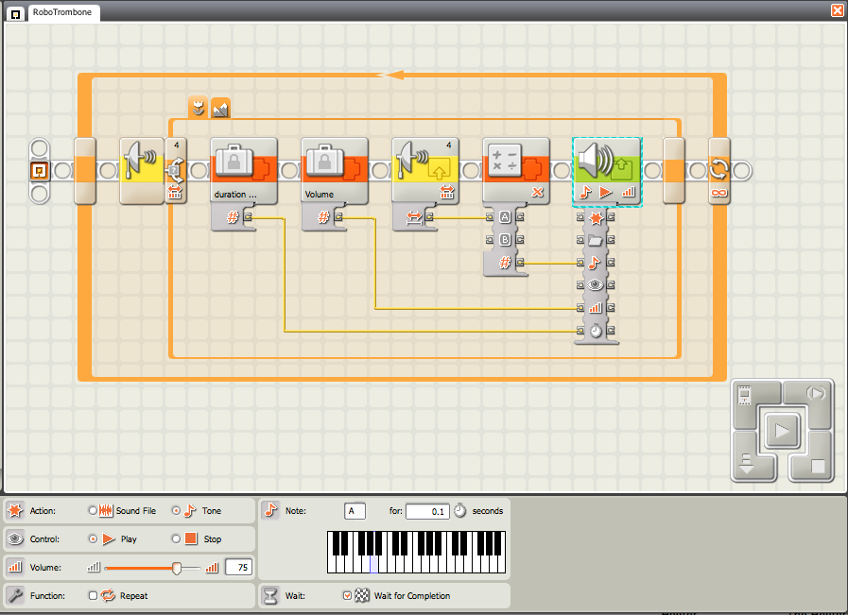
“RoboTrombone” – using wires
Hardware setup: Ultrasonic Sensor on Port 4 of NXT brick.
Program (Use Complete Set):
Common - Loop - forever
Flow – Switch - Sensor – Ultrasonic – Not Flat View – Port 4 – Compare Distance – any distance. Both branches do same steps next.
Data – suitcase – constant - enter number (50) for duration of each note. Wire to Sound as shown.
Data – suitcase – constant - number (75) for volume. Wire to Sound as shown.
Sensor – ultrasonic – Port 4 – Compare Distance <127 cm. Output wire to Multiply block.
Data – Math – Multiply sensor value times 50 to convert from cm to reasonable sound pitch.
Action – Sound – Tone, Play, Wait for Completion. Volume, Note and Duration come from the wires so no need to set them.
Download and Try It!
This robotic “musical instrument” is simple to build, but requires some more advanced programming. Many of the Mindstorms programming blocks have a little line on the bottom that opens up a “drawer” where you can hook up “wires” that can carry data to other blocks! Try it!

